Slide 1
Morphology and physiology of bacteria

Slide 2
Types of microorganisms
Type | Example | Disease
Bacteria | Mycobacterium tuberculosis | Tuberculosis
Viruses | Influenza virus | Flu
Fungi | Candida albicans | Candidiasis
Protozoa | Plasmodium | Malaria
Helminths | Tapeworm | Taeniasis
Prions | Abnormal proteins | Mad cow disease

Slide 3
bacteria
Bacteria are prokaryotic microorganisms that do not contain chlorophyll. They are unicellular and do not show true branching, except in the so-called 'higher bacteria' (Actinomycetales).
Some bacteria are beneficial, while others are pathogenic (disease-causing).

Slide 4
Characteristics of bacteria
Feature | Description
Cell type | Prokaryotic
Size | 0.2 – 5 µm
Shape | Cocci, Bacilli, Spiral
Reproduction | Asexual (Binary fission)
Genetic material | Circular DNA without nucleus
Motility | Some have flagella
Staining | Gram-positive or Gram-negative

Slide 5
Morphology of bacteria Common shapes:
Shape | Example
Cocci (round) | Staphylococcus
Bacilli (rod-shaped) | E. coli
Spirilla (spiral) | Helicobacter pylori
Vibrio (comma-shaped) | Vibrio cholerae

Slide 6
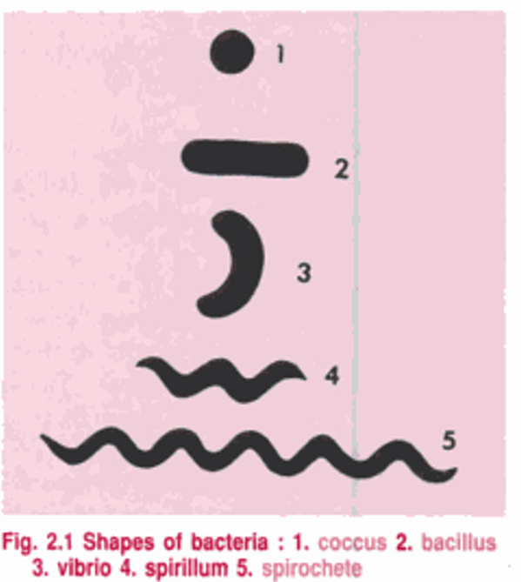

Slide 7
Classification based on gram staining
Type | Colour | Example
Gram-positive | Purple | Staphylococcus, Streptococcus
Gram-negative | Pink/Red | E. coli, Salmonella

Slide 8
Nutrition types
Type | Meaning | Example
Autotrophic | Make their own food | Cyanobacteria
Heterotrophic | Depend on organic matter | Most human pathogens

Slide 9
Reproduction
Mainly by Binary Fission
Genetic variation through:
Conjugation
Transformation
Transduction

Slide 10
Ueful Roles of Bacteria
✔ Nitrogen fixation (Rhizobium) ✔ Digestion (gut microbiota) ✔ Food industry (curd, cheese, vinegar) ✔ Antibiotic production (Streptomyces)

Slide 11
Diseases caused
Disease | Causative Bacteria
Tuberculosis | Mycobacterium tuberculosis
Cholera | Vibrio cholerae
Typhoid | Salmonella typhi
Diphtheria | Corynebacterium diphtheriae

Slide 12
Laboratory Identification
Microscopy
Gram staining
Culture
Biochemical tests
PCR
Serology

Slide 13
General size
Feature | Size
Length | 0.2 µm to 5 µm
Diameter (common cocci) | 0.5–1.0 µm
Rod-shaped bacteria (bacilli) | 1–10 µm long
Most medically important bacteria are around 1–2 um in size
Most bacteria range from 0.2 to 5 µm in size; smallest is Mycoplasma (0.2 um) and the largest is Thiomargarita namibiensis (up to 750 um).

Slide 14
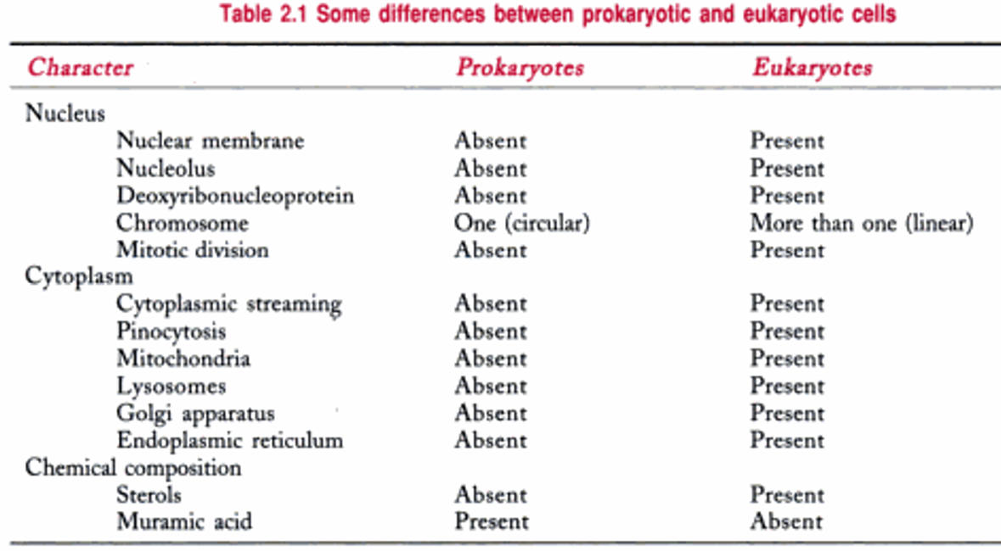

Slide 15
microscopy
Microscopy is the branch of science that deals with the use of microscopes to observe objects too small to be seen by the naked eye, such as bacteria, viruses, and cells.

Slide 16
Types of microscope
Category | Examples
Light Microscopy | Bright field, Dark field, Phase-contrast, Fluorescent
Electron Microscopy | Transmission (TEM), Scanning (SEM)

Slide 17
1. Light Microscopy
Uses visible light to illuminate specimens.
✔ Bright-Field Microscope
Most commonly used in labs
Specimen appears dark on a bright background
Used for: bacteria staining (Gram stain, AFB stain)
✔ Dark-Field Microscope
Specimen appears bright against a dark background
Used to see: live, thin, motile organisms (e.g., Treponema pallidum)

Slide 18
1. Light Microscopy
✔ Phase-Contrast Microscope
Enhances contrast in unstained, live specimens
Used to study cell motility and internal structures.
✔ Fluorescent Microscope
Uses UV light
Organisms appear fluorescent (glowing) due to dyes like auramine-rhodamine.
Used: TB diagnosis (AFB), viral antigen detection.

Slide 19
2. Electron Microscopy Uses electrons instead of light → provides very high resolution.
Type | Working | Image | Use
TEM (Transmission Electron Microscope) | Electrons pass through specimen | 2D | Internal structure of viruses & cells
SEM (Scanning Electron Microscope) | Electrons scan surface | 3D | Surface morphology of microbes

Slide 20
comparison: Light vs Electron Microscope
Feature | Light Microscope | Electron Microscope
Resolution | ~0.2 µm | 0.001 µm
Magnification | Up to 1000–2000× | Up to 50,000–100,000× or more
Live specimen | Yes | No
Cost | Cheap | Expensive

Slide 21
Stained Preparation
A stained preparation is a microscopy technique in which microorganisms are treated with stains (dyes) so they become more visible under a microscope. Staining improves contrast, visibility, shape, size, and arrangement of microbes.
Staining makes bacteria easier to observe and identify.

Slide 22
Purpose of Staining
Purpose | Example
To improve visibility | Shape and arrangement of bacteria
To identify organisms | Gram stain
To differentiate types | Acid-fast vs Non-acid fast
To study structure | Capsule, flagella, spores

Slide 23
Types of Stained Preparation
Type | Meaning | Example
Simple stain | Uses one dye | Methylene blue staining
Differential stain | Uses more than one dye to distinguish organisms | Gram stain, Acid-fast stain
Special stain | Highlights specific structures | Capsule stain, Endospore stain, Flagella stain

Slide 24
1. Simple Stain
Uses single dye
Shows basic morphology (shape + arrangement)
Example dyes: Methylene blue, Crystal violet, Safranin

Slide 25
2. Differential Stains
Stain | Purpose
Gram stain | Differentiates Gram+ (purple) and Gram− (pink)
Acid-fast stain (Ziehl-Neelsen) | Detects Mycobacterium tuberculosis

Slide 26
3. Special/Structural Stains
Stain | Structure Visualized
Capsule stain (India ink) | Capsules
Endospore stain (Schaeffer-Fulton) | Spores (green)
Flagella stain | Motility apparatus

Slide 27
General Steps in Stained Preparation
Smear preparation (spread specimen on slide)
Air drying
Heat fixing (kills bacteria and fixes to slide)
Applying stain
Rinsing and drying
Microscopic examination

Slide 28
Common stains used
Dye | Use
Crystal violet | Primary stain (Gram stain)
Safranin | Counterstain
Carbol fuchsin | Acid-fast stain
Methylene blue | Simple stain

Slide 29
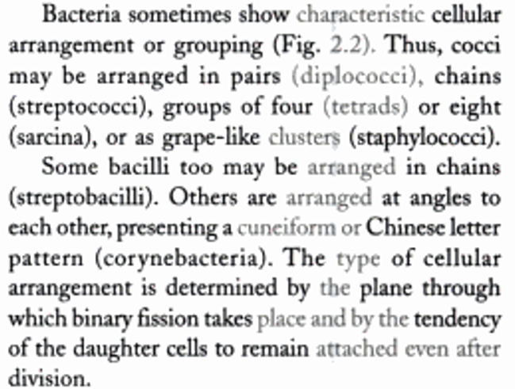

Slide 30
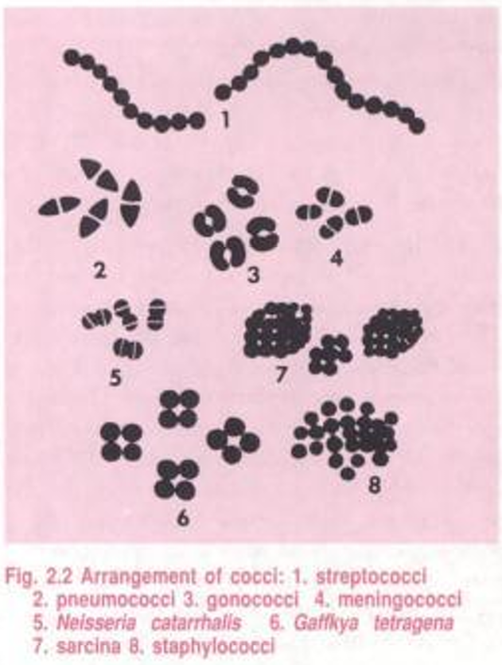

Slide 31
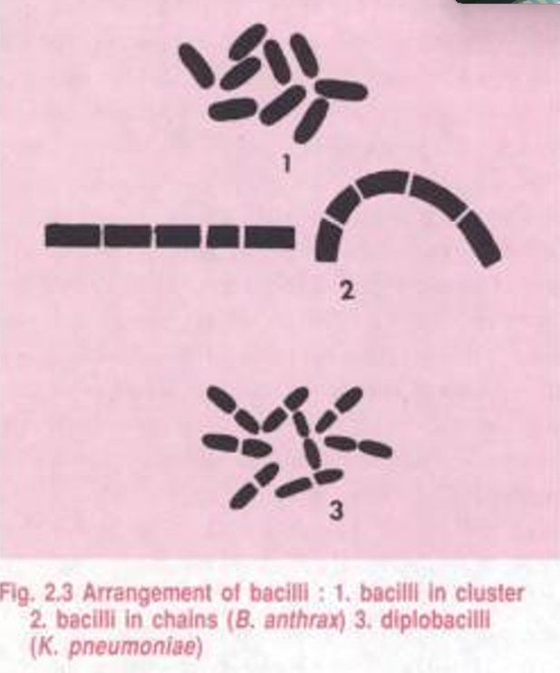

Slide 32
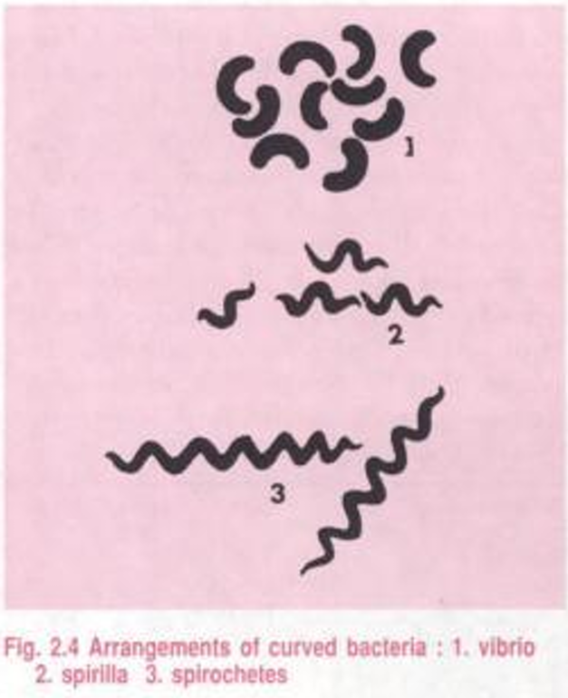

Slide 33
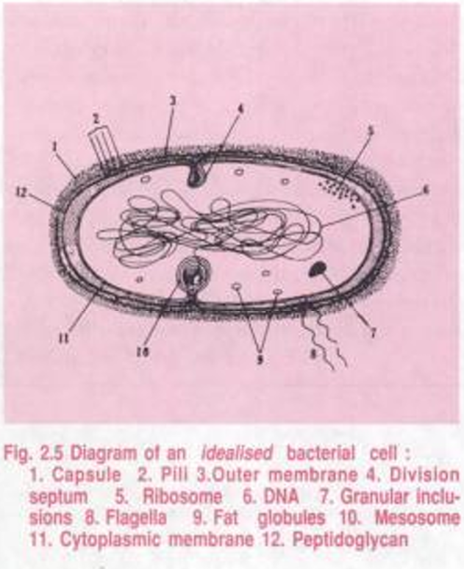

Slide 34
Bacterial anatomy
The outer layer or cell envelope consists of two components - a rigid cell wall and beneath it a cytoplasmic or plasma membrane.
The cell envelope encloses the protoplasm, comprising the cytoplasm, cytoplasmic inclusions such as ribosomes and mesosomes, granules, vacuoles and the nuclear body.
Besides these essential components, some bacteria may possess additional structures.
The cell may be enclosed in a viscid layer, which may be a loose slime layer, or organized as a capsule.
Some bacteria carry filamentous appendages protruding from the cell surface the flagella which are organs of locomotion and the fimbriae which appear to be organs for adhesion.

Slide 35
Cell wall
The bacterial cell wall is a rigid outer layer present outside the plasma membrane. It provides shape, strength, protection, and prevents bacteria from bursting (osmotic lysis).
It is made mainly of a unique compound called peptidoglycan (murein).

Slide 36
Functions of cellwall
Function | Importance
Gives shape | Cocci, bacilli, spirilla
Protects from osmotic pressure | Prevents bursting
Provides rigidity & strength | Maintains structure
Determines Gram reaction | Gram-positive or Gram-negative
Target for antibiotics | Penicillin, cephalosporins

Slide 37
Chemical Composition
✔ Peptidoglycan layer (main)
Made of:
NAG → N-acetylglucosamine
NAM → N-acetylmuramic acid
Linked with peptide bridges
✔ Other components:
Teichoic acid
Lipopolysaccharide (LPS)
Outer membrane (only Gram–negative)
Porin proteins

Slide 38
Types of Bacterial Cell Walls
✔ 1. Gram-Positive Cell Wall
Thick peptidoglycan retains crystal violet dye.
✔ 2. Gram-Negative Cell Wall
Loses crystal violet but takes safranin counterstain.

Slide 39
Gram positive cell wall
Feature | Detail
Peptidoglycan layer | Thick (20–80 nm)
Teichoic acid | Present
Outer membrane | Absent
Gram stain color | Purple
Example | Staphylococcus, Streptococcus

Slide 40
Gram negative cell wall
Feature | Detail
Peptidoglycan layer | Thin (2–7 nm)
Outer membrane | Present
Lipopolysaccharide (LPS) | Present (endotoxin)
Porin proteins | Present
Gram stain color | Pink/red
Example | E. coli, Salmonella

Slide 41
Special Types of Cell Walls
Type | Feature | Example
Acid-fast cell wall | Contains mycolic acid (waxy) | Mycobacterium tuberculosis
Lacking cell wall | No cell wall, flexible plasma membrane | Mycoplasma

Slide 42
Antibiotics Targeting Cell Wall
Penicillin
Cephalosporins
Vancomycin
Bacitracin
These inhibit peptidoglycan synthesis, causing bacteria to die.

Slide 43
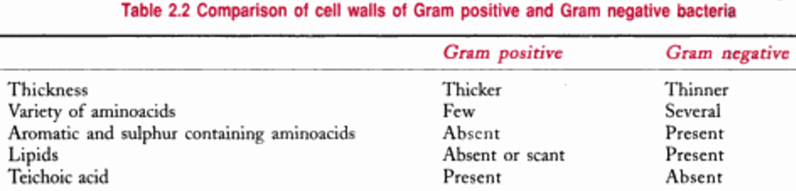

Slide 44
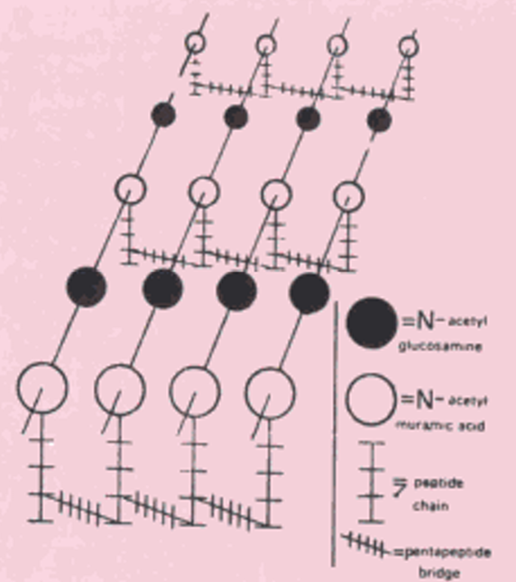

Slide 45
Cytoplasmic Membrane (Plasma Membrane)
The cytoplasmic membrane is a thin, flexible structure located just beneath the cell wall in bacteria. It controls the movement of substances in and out of the cell and plays a key role in metabolism.
Bacterial membranes DO NOT contain sterols, except Mycoplasma, which contains cholesterol.
Structure
The membrane is made of a phospholipid bilayer with proteins embedded in it, known as the:

Slide 46
"Fluid Mosaic Model"
Component | Function
Phospholipids | Form barrier; allow flexibility
Proteins | Transport, enzymes, receptors

Slide 47
Functions of cytoplasmic membrane
Function | Explanation
Selective permeability | Controls entry and exit of molecules
Transport mechanisms | Active transport, facilitated diffusion
Electron transport chain (ETC) | Site of respiration (because bacteria lack mitochondria)
Biosynthesis | Synthesis of lipids and cell wall precursors
Secretion | Export of toxins, enzymes
Osmotic balance | Maintains cell integrity

Slide 48
Special Features
Acts as a semi-permeable membrane
Contains membrane-bound enzymes
Essential for energy production (ATP synthesis)

Slide 49
Transport Types in Bacteria
Type | Example
Passive transport | Osmosis, diffusion
Facilitated diffusion | Transport proteins
Active transport | ATP-dependent pumps
Group translocation | PTS (Phosphotransferase system) – unique to bacteria

Slide 50
cytoplasm
The cytoplasm is a gel-like, semifluid substance inside the bacterial cell, enclosed by the cytoplasmic membrane. It contains various essential cellular components required for growth, metabolism, and reproduction.

Slide 51
components
Component | Function
Water (80–90%) | Medium for biochemical reactions
Enzymes & Metabolites | Carry out metabolic and biochemical processes
Proteins, carbohydrates, lipids | Structural and functional molecules
Ribosomes (70S) | Site of protein synthesis
Nucleoid (DNA) | Contains genetic material
Plasmids | Extra-chromosomal DNA; carries antibiotic resistance genes
Inclusion bodies | Storage granules (glycogen, polyphosphate, sulfur)
Cytoskeleton elements | Maintain cell shape and assist in division

Slide 52
Important Structures within Cytoplasm
1. Nucleoid
Contains single circular double-stranded DNA.
No nuclear membrane.
2. Ribosomes
70S type (50S + 30S subunits).
Target of antibiotics like tetracyclines and aminoglycosides.

Slide 53
Important Structures within Cytoplasm
3. Plasmids
Small circular DNA.
Provide resistance genes (R plasmids).
4. Inclusion Bodies
Examples:
Volutin (metachromatic granules) → Corynebacterium diphtheriae
Glycogen granules
Gas vacuoles (in cyanobacteria)

Slide 54
Functions of Cytoplasm
Metabolic activity center (glycolysis, biosynthesis)
Protein synthesis
Storage of nutrients
DNA replication and cell division

Slide 55
Ribosomes Ribosomes are small granular structures present in the bacterial cytoplasm and are responsible for protein synthesis.
Key Features: in table
Function:
Protein synthesis (translation).
Converts mRNA → protein.
Feature | Details
Type | 70S ribosomes
Subunits | 50S (large) + 30S (small)
Composition | rRNA (60%) + proteins (40%)
Location | Free in cytoplasm (not membrane-bound)
Sensitivity | Target of antibiotics like tetracyclines, streptomycin, chloramphenicol

Slide 56
Mesosomes (chondroids)
Mesosomes are infoldings of the cytoplasmic membrane seen mainly in Gram-positive bacteria.
Note: Mesosomes are now considered artifacts produced during chemical fixation in electron microscopy, not natural structures.
Types
Type | Function
Septal Mesosome | Associated with cell division (septum formation)
Lateral Mesosome | Associated with DNA replication, respiration

Slide 57
plasmids
Plasmids are small, circular, double-stranded DNA molecules found in the cytoplasm of bacteria, separate from the main chromosome.
They are self-replicating and not essential for survival, but they provide special advantages.
Feature | Description
Structure | Circular, double-stranded DNA
Location | Cytoplasm
Replication | Independent of bacterial chromosome
Essentiality | Not essential, but beneficial
Transfer | Can be transferred between bacteria (conjugation)

Slide 58
Functions of Plasmids
Carry genes for:
Antibiotic resistance (R-plasmids)
Toxin production
Virulence factors
Metabolic enzymes
Help in genetic exchange.

Slide 59
Importance in Biotechnology
Plasmids are used as vectors in genetic engineering because:
Easy to isolate
Can carry foreign genes
Can replicate inside bacterial cells

Slide 60
slime layer and capsule
Both slime layer and capsule are types of glycocalyx found outside the bacterial cell wall. They are made of polysaccharides, and sometimes polypeptides.

Slide 61
Capsule
A capsule is a thick, well-defined, tightly bound layer surrounding the bacterial cell.
Features:
Firmly attached to the cell wall
Organized and difficult to remove
Visible with special stains (e.g., India ink, Anthony’s stain)
Functions:
Protection from phagocytosis → increases virulence
Prevents desiccation (drying)
Helps bacteria escape host immune response
Aids in attachment to host tissues

Slide 62
Examples of Encapsulated Bacteria:
Bacteria | Capsule Composition
Streptococcus pneumoniae | Polysaccharide
Klebsiella pneumoniae | Polysaccharide
Bacillus anthracis | Polypeptide capsule (D-glutamic acid)

Slide 63
Slime Layer
A slime layer is a thin, loosely attached, unorganized surface coating.
Features:
Loosely bound; can be easily washed off
Thin and irregular
Mostly polysaccharides
Functions:
Helps in adhesion to surfaces
Important for biofilm formation (e.g., plaque on teeth by Streptococcus mutans)
Prevents drying (desiccation)
Provides protection from chemicals and environmental stress

Slide 64
differences
Feature | Capsule | Slime Layer
Attachment | Tightly attached | Loosely attached
Organization | Well-organized | Unorganized
Thickness | Thick | Thin
Removal | Hard to remove | Easily removed
Staining | Visible with special stains | Often not visible
Role in Virulence | High | Low to moderate
Example | Streptococcus pneumoniae | Streptococcus mutans (dental plaque)

Slide 65
flagella
Part | Location | Function
Filament | Outside the cell | Long, helical structure made of flagellin
Hook | Attached to basal body | Flexible connector between filament and basal body
Basal body | Anchored in cell wall and membrane | Acts as a motor that rotates the flagellum
Flagella are long, whip-like, thread-like appendages present on the surface of some bacteria. They provide motility and help bacteria move toward nutrients or away from harmful substances (chemotaxis).
Composition
Flagella are made of a protein called flagellin.
Structure of Flagellum
A bacterial flagellum has three main parts: in table
In gram-negative bacteria, the basal body has 4 rings (L, P, MS, C).
In gram-positive bacteria, it has 2 rings (MS, C).

Slide 66
Function of Flagella
Enables bacterial motility
Helps in chemotaxis (movement toward attractants like nutrients or away from toxins)
Aids in colonization and infection

Slide 67
Types of flagellar movements
Type | Description | Example
Monotrichous | Single flagellum at one pole | Vibrio cholerae
Lophotrichous | Tuft (cluster) of flagella at one pole | Helicobacter pylori
Amphitrichous | One or more flagella at both poles | Spirillum volutans
Peritrichous | Flagella all over the surface | E. coli, Proteus
Atrichous | No flagella | Klebsiella, Shigella

Slide 68
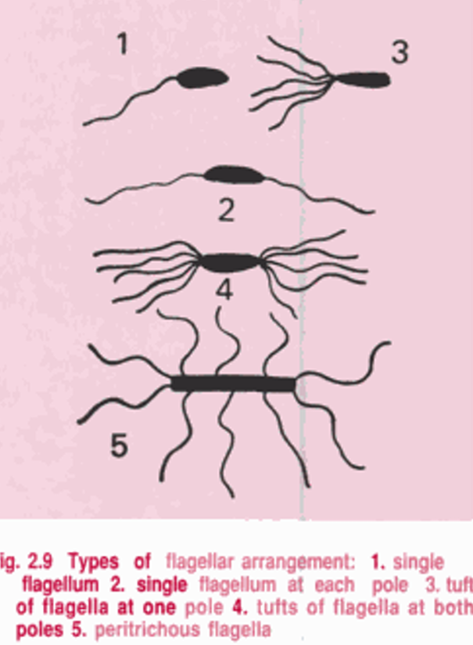
Detection of Flagella
Hanging drop method → to observe motility
Flagella stain (special stain)
Motility agar

Slide 69
Fimbriae and pili
Fimbriae and pili are hair-like surface appendages found in many bacteria. They are thinner and shorter than flagella and do not provide motility (except sex pili used in conjugation, not for movement).
Both are made mostly of a protein called pilin.

Slide 70
fimbriae
Feature | Description
Number | Numerous (100–300 per cell)
Length | Short and thin
Location | Cover the entire bacterial surface
Composition | Pilin protein
Function | Mainly attachment (adhesion)

Slide 71
fimbriae
Function:
Helps bacteria attach to host tissues, surfaces, and prosthetic devices.
Important in establishing infection and colonization.
Helps in biofilm formation.
Examples:
Neisseria gonorrhoeae uses fimbriae to attach to genital mucosa.
E. coli fimbriae help in urinary tract infections.

Slide 72
pili
Feature | Description
Number | Few (1–10 per cell)
Length | Longer than fimbriae
Types | Sex (F) pili and common pili
Function | Conjugation and sometimes adhesion

Slide 73
pili
Function:
Sex (F) pilus is involved in bacterial conjugation (transfer of DNA/plasmids from donor → recipient).
Helps in antibiotic resistance gene transfer.
Some pili help in attachment, but not as strongly as fimbriae

Slide 74
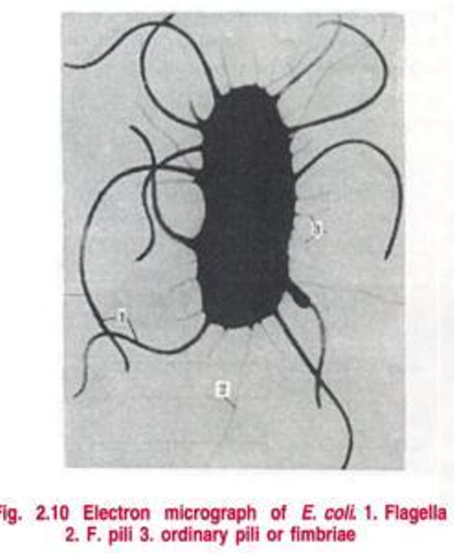

Slide 75
Growth and Multiplication of Bacteria
Bacteria grow by increase in cell mass and multiply by binary fission, a simple asexual reproduction method.

Slide 76
Binary Fission (Main Method of Multiplication)
Binary fission is a process where one bacterial cell divides to form two identical daughter cells.
Steps of Binary Fission:
Cell Growth
Bacterial cell increases in size.
DNA Replication
Chromosome duplicates and attaches to the cell membrane.
Segregation
Two DNA copies move to opposite poles of the cell.
Septum Formation
Cell membrane and wall invaginate and form a division septum.
Cell Separation
Parent cell splits into two genetically identical daughter cells.

Slide 77
Generation Time The time required for a bacterium to divide into two cells. Varies between species and conditions.
Bacteria | Generation Time
E. coli | 20 minutes
Mycobacterium tuberculosis | 18–24 hours
Vibrio cholerae | 20 minutes
Staphylococcus aureus | 30 minutes

Slide 78
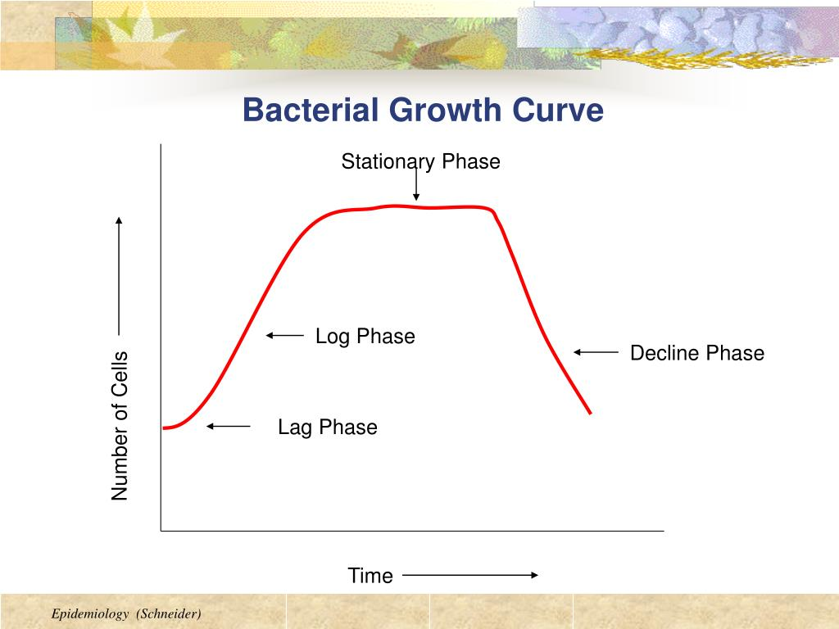
Growth Curve of Bacteria When bacteria are cultured in a closed environment, they follow a growth curve with 4 phases. S-shaped (sigmoid curve)
Phase | Description | Key Features
1. Lag Phase | Adaptation to environment | No cell division
2. Log/Exponential Phase | Rapid binary fission | High metabolic activity; most sensitive to antibiotics
3. Stationary Phase | Growth = Death | Nutrients deplete, toxins accumulate
4. Death/Decline Phase | Death > Growth | Cells die due to toxic waste and lack of nutrients

Slide 79
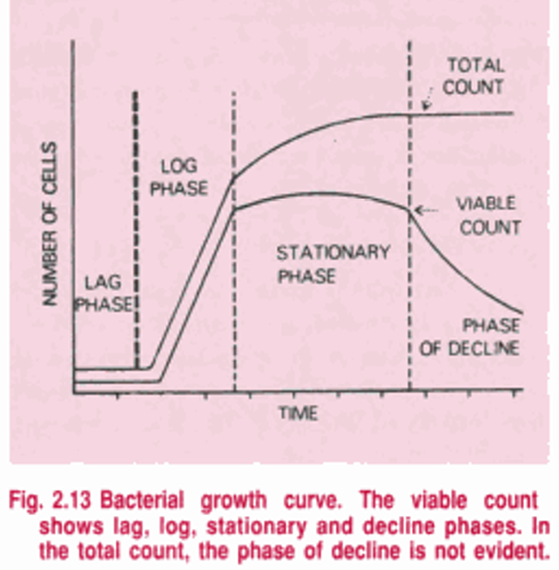

Slide 80
Factors affecting growth
Factor | Effect
Temperature | Psychrophiles, mesophiles, thermophiles
pH | Most bacteria prefer neutral pH (7.0)
Oxygen | Aerobes, anaerobes, facultative anaerobes
Moisture | Essential for growth
Nutrients | Carbon, nitrogen, minerals, vitamins

Slide 81
Methods to measure bacterial growth
Method | Example
Direct count | Microscopy
Viable count | Colony count (CFU)
Turbidometry | Spectrophotometer
Metabolic activity | CO₂ production

Slide 82
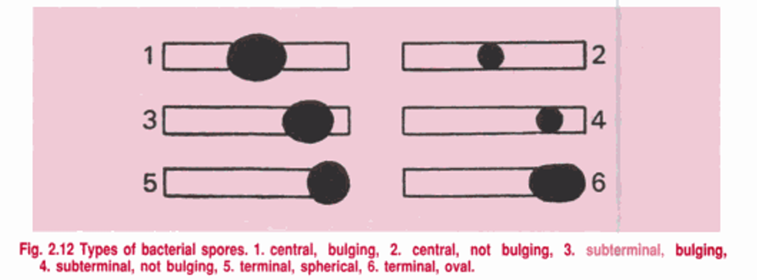

Slide 83
Bacterial nutrition
Bacteria require nutrients for growth, metabolism, reproduction, and energy production. These nutrients come from the environment and vary based on the type of bacteria.
Type of Nutrient | Examples | Function
Macronutrients | C, H, O, N, P, S | Structure and cellular metabolism
Micronutrients (Trace elements) | Fe, Zn, Mn, Cu, Mg | Enzyme function and co-factors
Growth factors | Vitamins, amino acids, purines, pyrimidines | Required by some bacteria that cannot synthesize them

Slide 84
Source of energy
Type | Bacteria Example | Description
Phototrophs | Cyanobacteria | Use sunlight as energy
Chemotrophs | Nitrifying bacteria | Use chemical compounds
Source of carbon
Type | Source | Example
Autotrophs | Use CO₂ as carbon source | Cyanobacteria
Heterotrophs | Use organic compounds | Most pathogenic bacteria

Slide 85
Source of electron (reducing power)
Type | Source | Example
Lithotrophs | Inorganic substances (H₂, NH₃, Fe²⁺) | Nitrifying bacteria
Organotrophs | Organic compounds | Most human pathogens

Slide 86
Classification Combining Carbon, Energy & Electron Source
Type | Energy | Carbon | Electrons | Example
Photoautotrophs | Light | CO₂ | Inorganic | Cyanobacteria
Photoheterotrophs | Light | Organic | Organic | Purple non-sulfur bacteria
Chemoautotrophs (Lithoautotrophs) | Chemicals | CO₂ | Inorganic | Nitrosomonas
Chemoheterotrophs | Chemicals | Organic | Organic | Most pathogenic bacteria (E.coli)

Slide 87
Oxygen requirement
Type | Requirement | Example
Obligate aerobes | Need O₂ | Mycobacterium tuberculosis
Obligate anaerobes | Cannot tolerate O₂ | Clostridium
Facultative anaerobes | Grow with or without O₂ | E. coli
Microaerophiles | Require low O₂ | Helicobacter pylori
Aerotolerant anaerobes | Do not use O₂ but tolerate it | Lactobacillus

Slide 88
Nutritional Types Based on Growth Requirement
Type | Requirement | Example
Simple bacteria | Grow in minimal media | E. coli
Fastidious bacteria | Require special nutrients (blood, serum, vitamins) | Neisseria, Haemophilus
Transport of Nutrients
Mechanism | Type | Example
Passive diffusion | No energy | Gases, small molecules
Facilitated diffusion | Carrier protein, no energy | Glycerol
Active transport | Energy required | Amino acids
Group translocation | Substance chemically modified during transport | Glucose → glucose-6-phosphate in bacteria

Slide 89
Factors affecting growth
Bacterial growth is influenced by physical, chemical, and nutritional factors in their environment. Any change in these factors may inhibit growth or kill bacteria.
Factor | Effect on Growth
Temperature | Controls enzyme activity
pH | Affects membrane + enzyme function
Oxygen | Needed or toxic depending on type
Moisture | Necessary for metabolism
Osmotic Pressure | High salt/sugar inhibits
Light | UV kills; some need sunlight
Pressure | Some adapted to high pressure
Nutrients | Required for metabolism and reproduction
Inhibitory Substances | Prevent growth
Time | Determines growth phase

Slide 90
Temperature
Type | Optimum Temp | Example
Psychrophiles | 0–20°C | Arctic bacteria
Psychrotrophs | 20–30°C (grow in fridge) | Listeria
Mesophiles | 25–40°C | Most pathogens (E. coli, Staphylococcus)
Thermophiles | 45–70°C | Compost bacteria
Hyperthermophiles | >80°C | Hot spring bacteria

Slide 91
ph
Type | Preferred pH | Example
Neutrophiles | 7 | Pathogenic bacteria
Acidophiles | pH < 6 | Lactobacillus (yogurt)
Alkaliphiles | pH > 8 | Vibrio cholerae (optimal ~8.5–9)

Slide 92
Oxygen requirement
Type | Oxygen Use | Example
Obligate aerobes | Require O₂ | Mycobacterium
Obligate anaerobes | Killed by O₂ | Clostridium
Facultative anaerobes | Grow with or without O₂ | E. coli
Microaerophiles | Need low O₂ (5–10%) | Helicobacter pylori
Aerotolerant anaerobes | Not affected by O₂ | Lactobacillus

Slide 93
Moisture / Water Availability
Water is essential for enzyme activity and nutrient transport.
Dry conditions inhibit bacterial growth.
Exceptions: spores and some fungi can survive dryness.
Measured using water activity (Aw) → bacteria prefer Aw ≥ 0.97

Slide 94
Osmotic Pressure
Hypertonic environment (high salt/sugar) causes plasmolysis → cells shrink and stop growing.
Used in salted meat, jams, pickles for preservation.
Adaptation | Example
Halophiles (salt-loving) | Halobacterium
Non-halophiles | Most pathogens

Slide 95
Light
UV light causes DNA damage → thymine dimers → bacterial death.
Some bacteria (cyanobacteria) need light for photosynthesis.
Most bacteria grow at normal atmospheric pressure.
Barophiles / Piezophiles grow at high pressure (deep sea microbes).
Pressure

Slide 96
Nutrients
Growth depends on availability of:
Carbon source
Nitrogen
Minerals (Fe, Mg, K, Ca, Zn)
Vitamins and growth factors
Fastidious organisms (e.g., Neisseria, Haemophilus) need enriched media like blood or serum.

Slide 97
Inhibitory Substances
Substance | Effect
Antibiotics | Kill or inhibit bacteria
Disinfectants | Damage membrane or proteins
Waste products | Acid accumulation inhibits growth (e.g., lactic acid from Lactobacillus)

Slide 98
Time
Bacteria require time to adapt and increase cell number (lag, log, stationary, death phases).

